Slide 1

New Jersey Center for Science, Technology, and Mathematics Education
Schematic Presentation
John P. Mulhern
November 21, 2008

Slide 2
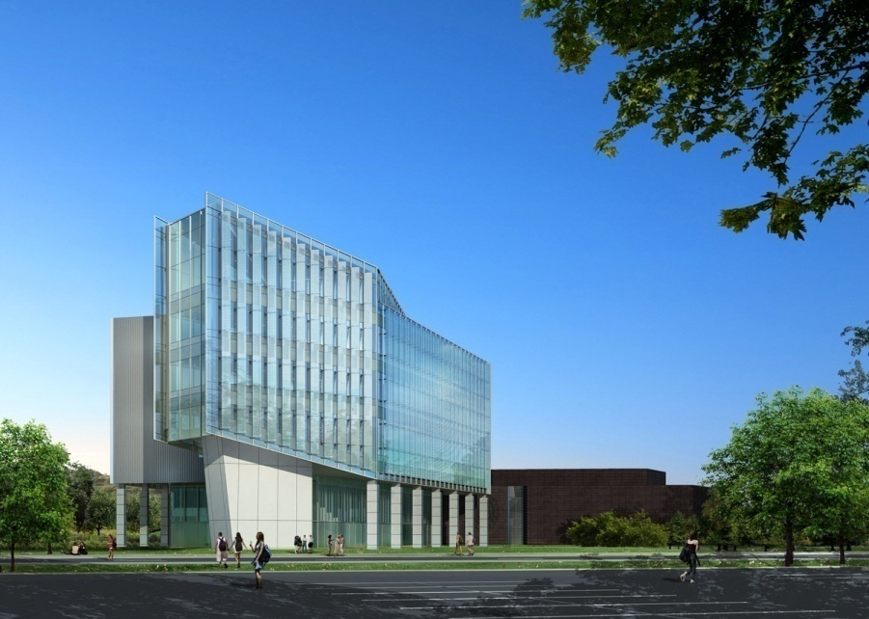
Building Information
Notes:
Name: New Jersey Center for Science, Technology, and Mathematics Education
Owner: Kean University
Location: Union, NJ
Size: 117,000 ft²
Floors: 6
Cost: $45,000,000
Architect: Cannon Design, Inc

Slide 3
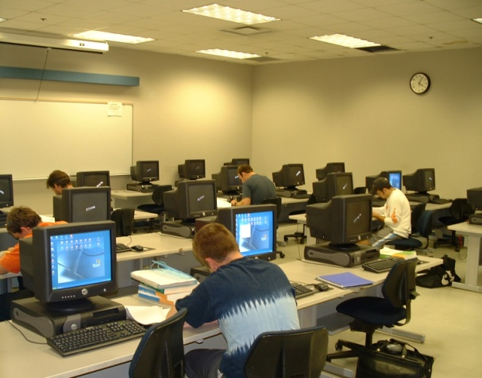
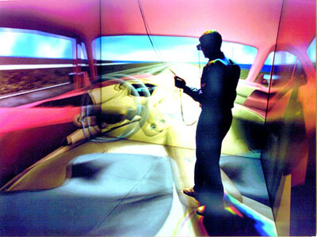
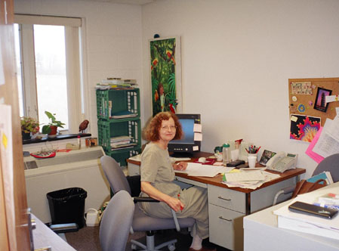
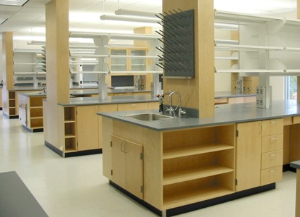
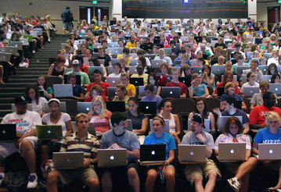
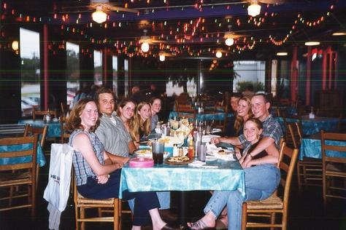
Uses
http://www.aviationtechcenter.com/images2/Computer_lab.jpg
http://www.engin.umich.edu/caen/campcaen/ph otos/cave_princecar.jpg
http://www.allegany.edu/bedford/Images/BCCFacCWsmall.jpg
http://constructlab.com/images/College%20University%20(23)%20cropped%20small.JPG
http://paulstamatiou.com/wp-content/ uploads/ 2007/10/mizzou_macs.jpg
http://photos.igougo.com/images/p9423-College_Station-My_22nd_Birthday_at_Garcias.jpg
Notes:
This building has many uses
College Laboratories
Computer Labs
Classrooms
300 Seat Auditorium
3D Cave
Double Height Lobby
Executive Center
Exhibition Space
Faculty Offices
Future Restaurant

Slide 4

Design Theme
Notes:
There are three disciplines in this building: Science, Technology, And Mathematics
There is one thing which connects all the disciplines → The Computer
The computer allows for every discipline to perform at a higher level
Think of all the faculty and students in every subject as computer chips
They like computer chips all perform separate tasks
The computer chips perform the tasks for the main goal of a function
The people in the three disciplines perform tasks for the main goal of knowledge
The chips need paths to each other to complete their tasks, and people need to know their paths to each other in the building
This will be accomplished by using light

Slide 5
Overall Design Goals
Guide visitors through the irregular shape building with light
Provide a modern appearance
Present this building as the “pearl” of the campus as Kean University intended
Provide sufficient light levels for students
Notes:
This building has a very irregular shape
The paths are not symmetrical like most buildings and the way to go is not very obvious
Need light to guide people on their way
This building has a very modern aesthetic so this theme will be applied throughout the space
Fixtures and design should be of high quality because this will be the nicest building on Kean’s campus
Kean University staff is very proud of this project they worked hard for to build
This is a learning environment and proper light levels only help students’ potential to learn

Slide 6
Redesign Space Choices
Outdoor Space in front of south façade
Classroom
Lower Lobby
Auditorium

Slide 7
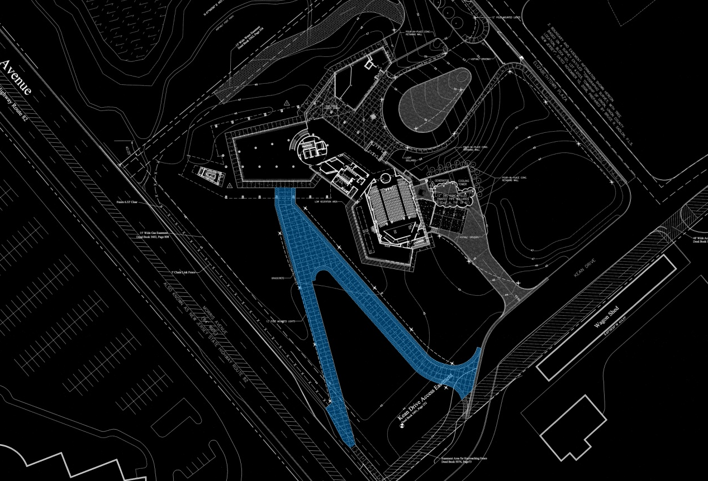
General Info
Outdoor Space Classroom Lower Lobby Auditorium
Notes:
Location: Outside in front of south façade
The pathway is made of concrete with grasscrete along the edges
Grasscrete is a honeycomb shape of concrete that has grass poking through the holes

Slide 8
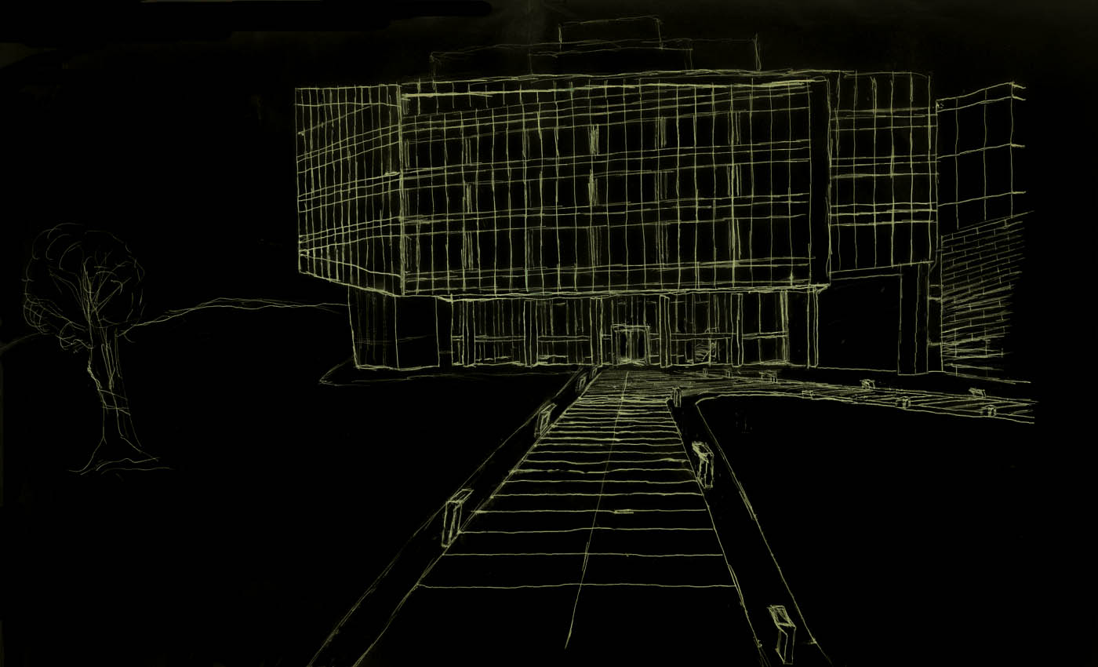

General Info
Brick
Composite
Metal Panel
Grasscrete
Curtainwall
Concrete
Outdoor Space Classroom Lower Lobby Auditorium
Notes:
Location: Outside in front of south façade
The pathway is made of concrete with grasscrete along the edges
Grasscrete is a honeycomb shape of concrete that has grass poking through the holes

Slide 9
Design Goals
Provide a modern appearance
Present this building as the “pearl” of the campus as Kean University intended
Bring out depth of portico for dramatic effect
Fixtures glowing at night
Outdoor Space Classroom Lower Lobby Auditorium
Notes:
This building is Kean University’s pride and joy
The exterior should reflect the interior
Continue the modern theme with fixtures of a modern aesthetic
Achieve a sparkle effect at night to enhance the awe impression desired

Slide 10
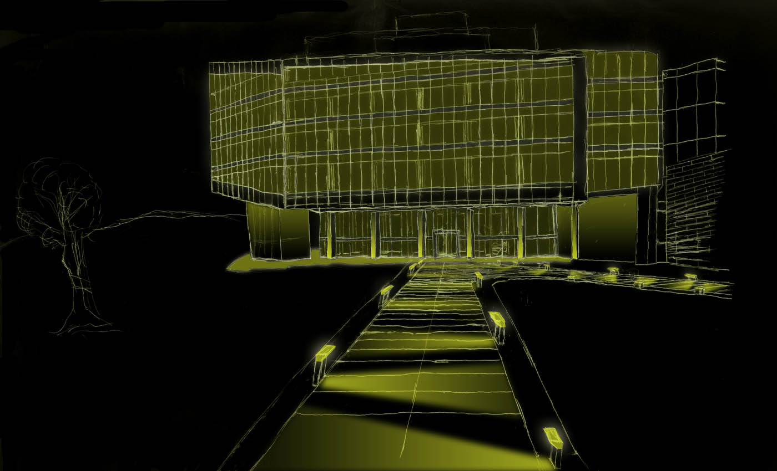
General Info
Glow from
within
Light columns
for depth
Glow at night
Small path
Lighting fixture
Outdoor Space Classroom Lower Lobby Auditorium
Notes:
Location: Outside in front of south façade
The pathway is made of concrete with grasscrete along the edges
Grasscrete is a honeycomb shape of concrete that has grass poking through the holes

Slide 11
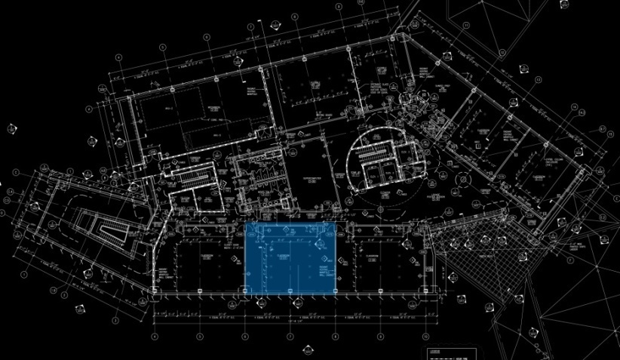
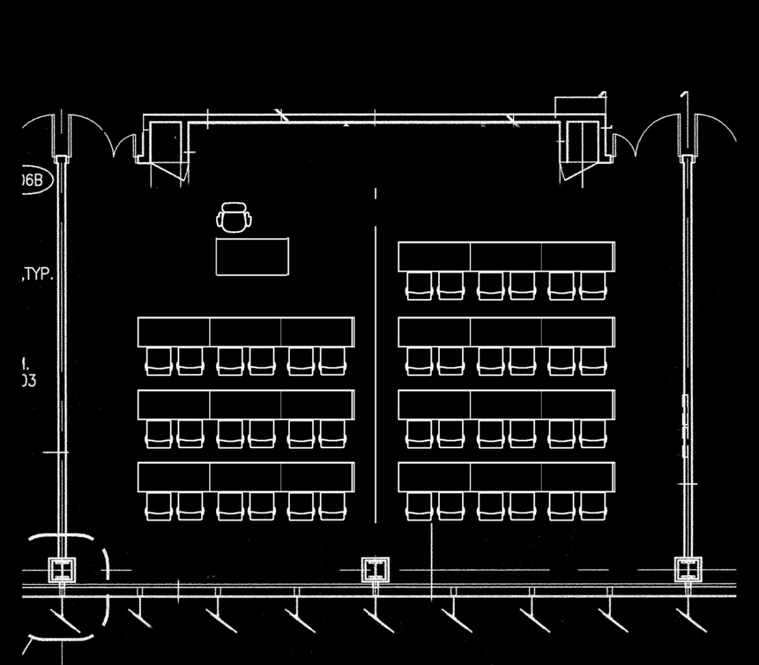
General Info
Outdoor Space Classroom Lower Lobby Auditorium
Notes:
Location: 3rd Floor
Materials
Fabric Wall Panels
Carpet Tiles for floor
ACT Ceiling
Plastic Laminate Desks and Chairs
GWB for parts of wall
Tasks
Reading
Writing
Observing Whiteboard
Ceiling Height
9’6” for most of space
8’0” near the whiteboard

Slide 12
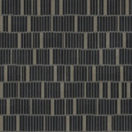

General Info
Whiteboard on GWB
Carpet Tile Floor
Fabric Wall Panel
Curtainwall w/ solar shades
Outdoor Space Classroom Lower Lobby Auditorium
Notes:
Fabric Wall Panels along the side walls
Dark color so not a good choice for visual clarity because it is a low reflectance material
The whiteboard is made of glass and is glossy
There is full height south facing curtainwall

Slide 13
Design Goals
Achieve impression of visual clarity
Emphasis of whiteboard
Adequate illuminance for learning
Minimize glare for students
Outdoor Space Classroom Lower Lobby Auditorium
Notes:
Trying to achieve a subjective impression of visual clarity
Uniform peripheral empahsis
Slight emphasis of whiteboard to attract attention
Uniform distribution on task plane
Illuminate ceiling as well
Glare is a nusiance and should be avoided at all times

Slide 14
Design Concepts
Emphasis of
Whiteboard
Uniform
Wall Wash
Uniform
Wall Wash
Outdoor Space Classroom Lower Lobby Auditorium
Notes:
For this space, uniform wall washes are desired on the side walls
The wash of the whiteboard should be slightly higher than the other walls to attract students attention

Slide 15
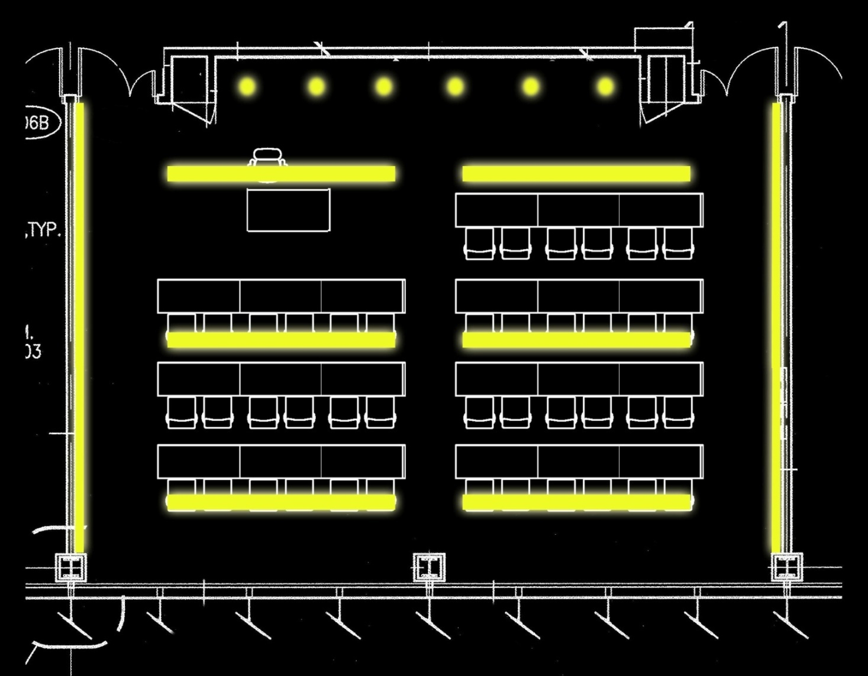
Design Concepts
Recessed Wall Washer
Indirect Linear
Luminaire
Outdoor Space Classroom Lower Lobby Auditorium
Notes:
For this space, uniform wall washes are desired on the side walls
The wash of the whiteboard should be slightly higher than the other walls to attract students attention

Slide 16

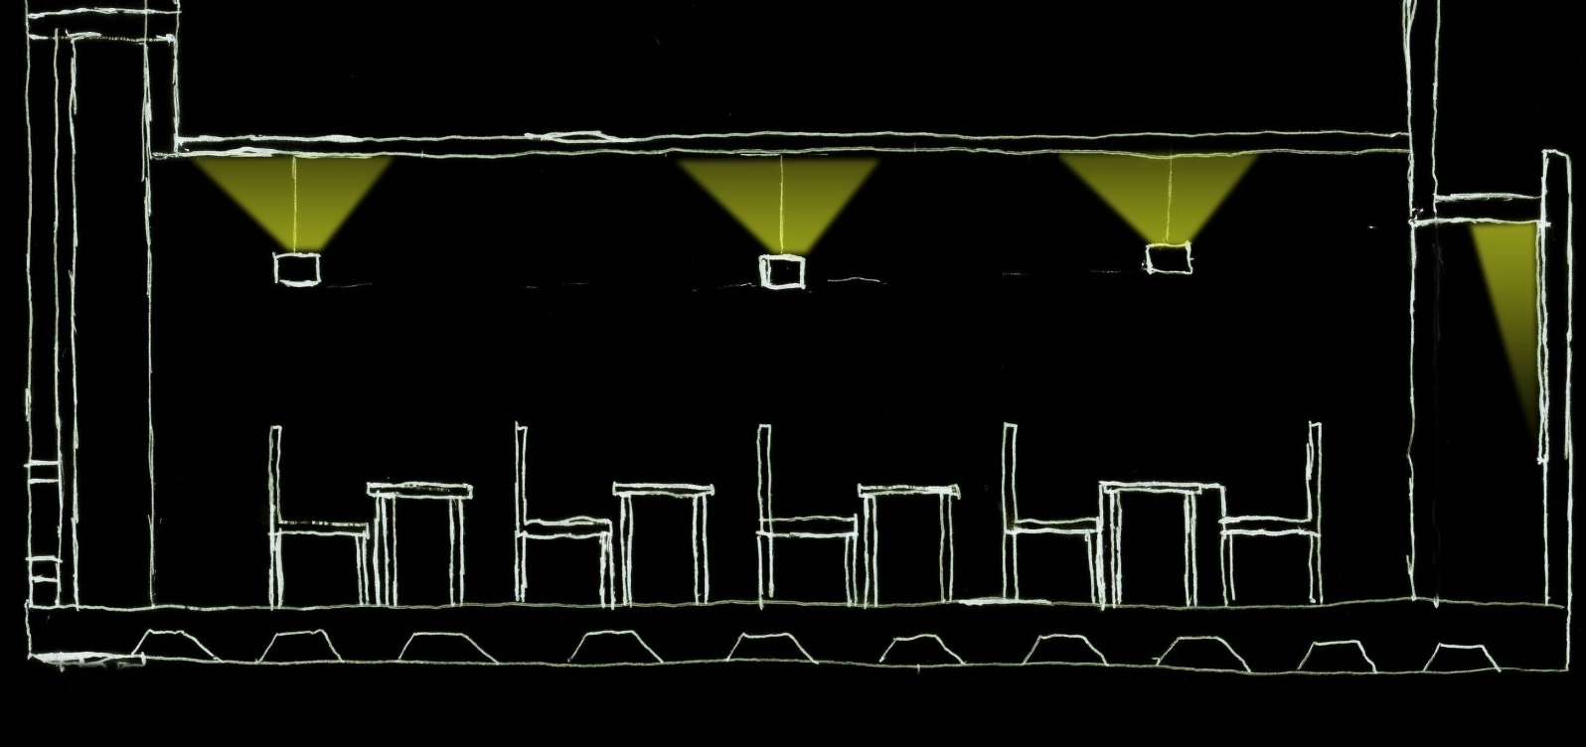
Section
Uniform Wall Wash Whiteboard
10’
8’6”
Illuminate ceiling and indirect light for task plane
Outdoor Space Classroom Lower Lobby Auditorium
Notes:
Illuminate task plane on desks uniformly
Also illuminate ceiling as well to help achieve visual clarity impression
To illuminate ceiling luminaires will need to be suspended
Luminaires are arrayed so there is no visual clutter
Curtainwall on left is pointless to wash since it is mostly glass

Slide 17
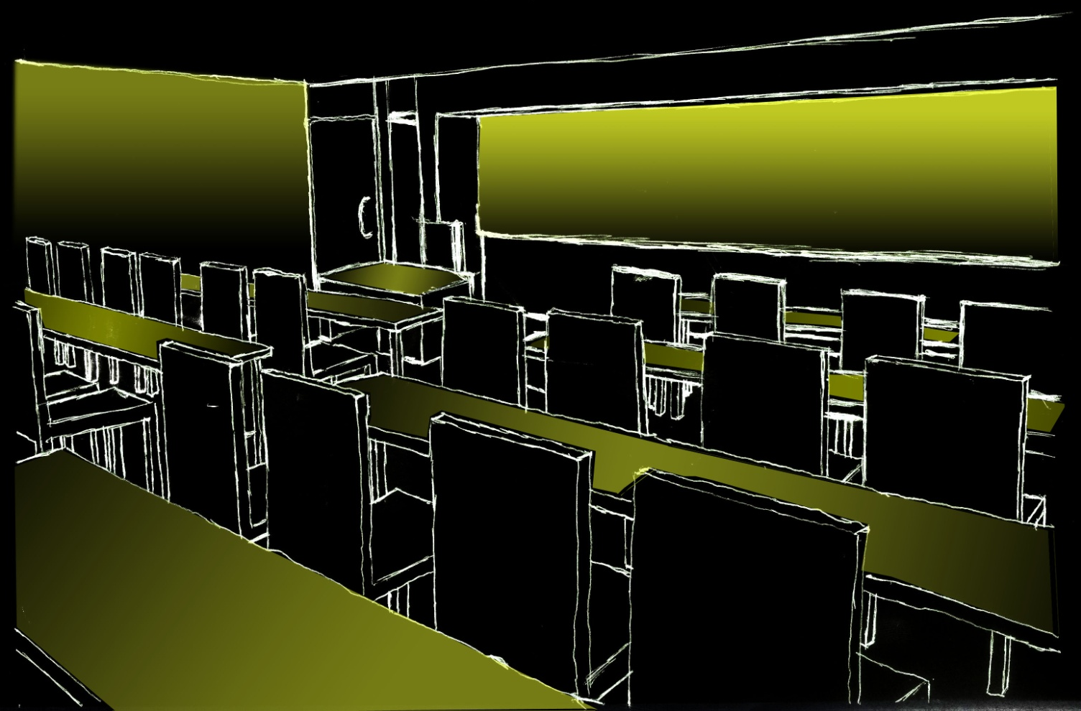
Design Concepts
Emphasis of
Whiteboard
Uniform
Wall Wash
Uniform
Task
Distribution
Outdoor Space Classroom Lower Lobby Auditorium
Notes:
Uniform task light distribution for ease of reading and writing
Whiteboard as you can see is emphasized compared to the other wall wash
Ceiling was not illuminated for clarity of this perspective sketch

Slide 18
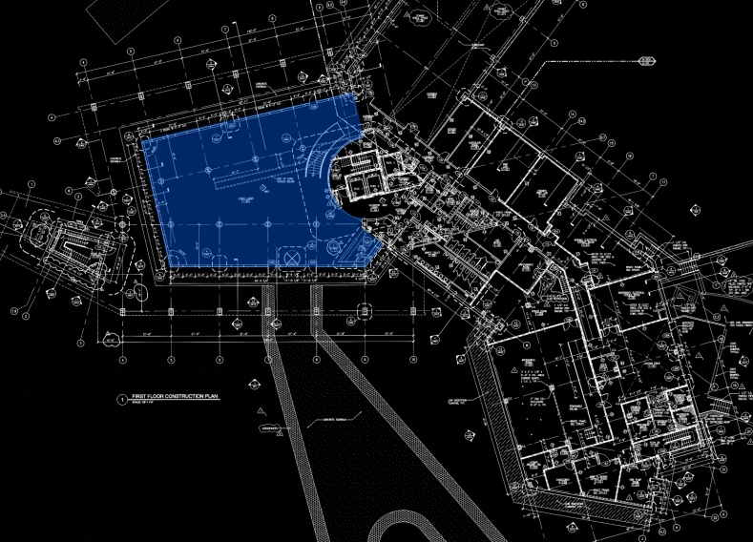
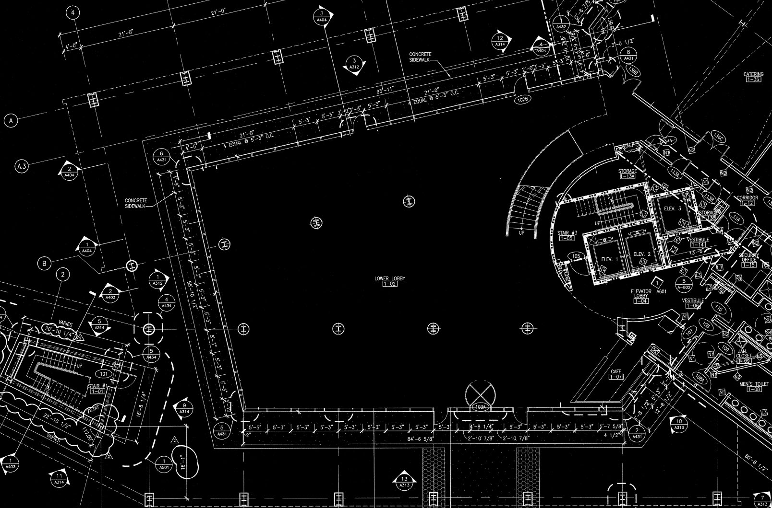
General Information
Outdoor Space Classroom Lower Lobby Auditorium
Notes:
Location
1st
This is the highlight of all the spaces in the building
Double height space at a 19’ ceiling height
Monumental staircase is a major point of interest
Functions
General Lobby during the day
Holds galas periodically at night
Tasks
Nothing set in stone
Just general lounging

Slide 19
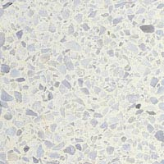
General Information
Terazzo
Tile
Curved Ceramic
Tile Wall
Grand Staircase
Columns could cause scallops
Curtainwall
Outdoor Space Classroom Lower Lobby Auditorium
Notes:
Location
1st
This is the highlight of all the spaces in the building
Double height space at a 19’ ceiling height
Monumental staircase is a major point of interest
Functions
General Lobby during the day
Holds galas periodically at night
Tasks
Nothing set in stone
Just general lounging

Slide 20
Design Goals
Achieve impression of public atmosphere
Translate grandeur of building into this important space
Light to guide to different spaces
Cool Tones for daytime and warm tones for nighttime if possible
Accent café area and curved ceramic tile wall
Daylight integration
Outdoor Space Classroom Lower Lobby Auditorium
Notes:
Want to achieve public impression during day
High illuminance levels especially with double height south facing curtainwall
Cool tones
Uniform distribution
Difficult for visitor to know where to go especially finding elevator
Need to attract people with light to the elevator lobby
During the day cool tones are needed for the function of a general lobby
At night warm tones will be needed ebcause of the galas being held

Slide 21
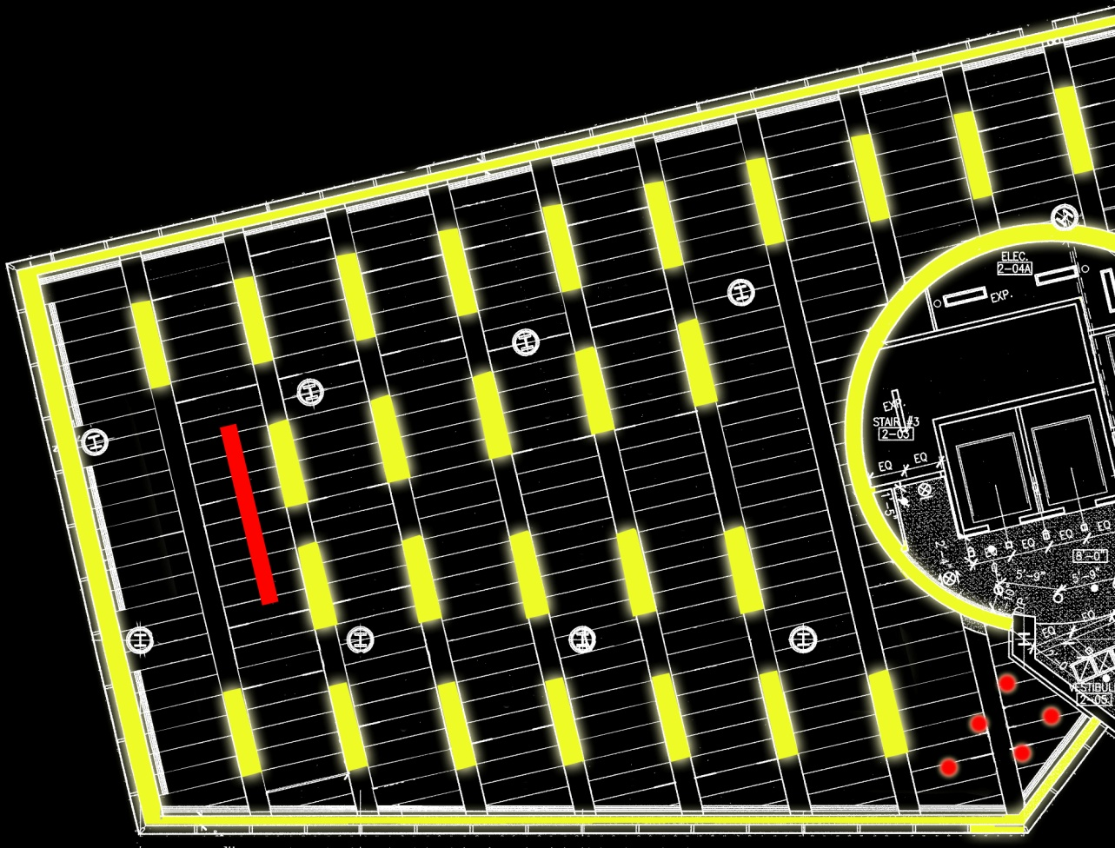
Option 1
Linear recessed luminaire
Cove lighting
for accenting
ceramic tile wall
Track lighting
for presentations
Pendants for
café area
Outdoor Space Classroom Lower Lobby Auditorium
Notes:
The two systems would not be turned on simultaneously
Cool toned strips for daytime
Recessed into ceiling to not take away from unique architecture of ceiling
Warm toned downlighting for night time
Also recessed
The two floors of the levator lobby have wall washes
The upper floor is washed as a point of interest
The lower wall is washes to guide people to the elevators because it is most apparent

Slide 22
Option 1
Path to rest of 1st Floor
Outdoor Space Classroom Lower Lobby Auditorium
Notes:
The two systems would not be turned on simultaneously
Cool toned strips for daytime
Recessed into ceiling to not take away from unique architecture of ceiling
Warm toned downlighting for night time
Also recessed
The two floors of the levator lobby have wall washes
The upper floor is washed as a point of interest
The lower wall is washes to guide people to the elevators because it is most apparent

Slide 23
Option 1
Path to Grand Staircase
Outdoor Space Classroom Lower Lobby Auditorium
Notes:
The two systems would not be turned on simultaneously
Cool toned strips for daytime
Recessed into ceiling to not take away from unique architecture of ceiling
Warm toned downlighting for night time
Also recessed
The two floors of the levator lobby have wall washes
The upper floor is washed as a point of interest
The lower wall is washes to guide people to the elevators because it is most apparent

Slide 24
Option 1
Path to Elevator Lobby
Outdoor Space Classroom Lower Lobby Auditorium
Notes:
The two systems would not be turned on simultaneously
Cool toned strips for daytime
Recessed into ceiling to not take away from unique architecture of ceiling
Warm toned downlighting for night time
Also recessed
The two floors of the levator lobby have wall washes
The upper floor is washed as a point of interest
The lower wall is washes to guide people to the elevators because it is most apparent

Slide 25
Option 1
Path to Café Area
Outdoor Space Classroom Lower Lobby Auditorium
Notes:
The two systems would not be turned on simultaneously
Cool toned strips for daytime
Recessed into ceiling to not take away from unique architecture of ceiling
Warm toned downlighting for night time
Also recessed
The two floors of the levator lobby have wall washes
The upper floor is washed as a point of interest
The lower wall is washes to guide people to the elevators because it is most apparent

Slide 26
Option 1
Dimming of outlined rows for galas at night
Keep perimeter lighting at a higher luminance
Outdoor Space Classroom Lower Lobby Auditorium
Notes:
The two systems would not be turned on simultaneously
Cool toned strips for daytime
Recessed into ceiling to not take away from unique architecture of ceiling
Warm toned downlighting for night time
Also recessed
The two floors of the levator lobby have wall washes
The upper floor is washed as a point of interest
The lower wall is washes to guide people to the elevators because it is most apparent

Slide 27
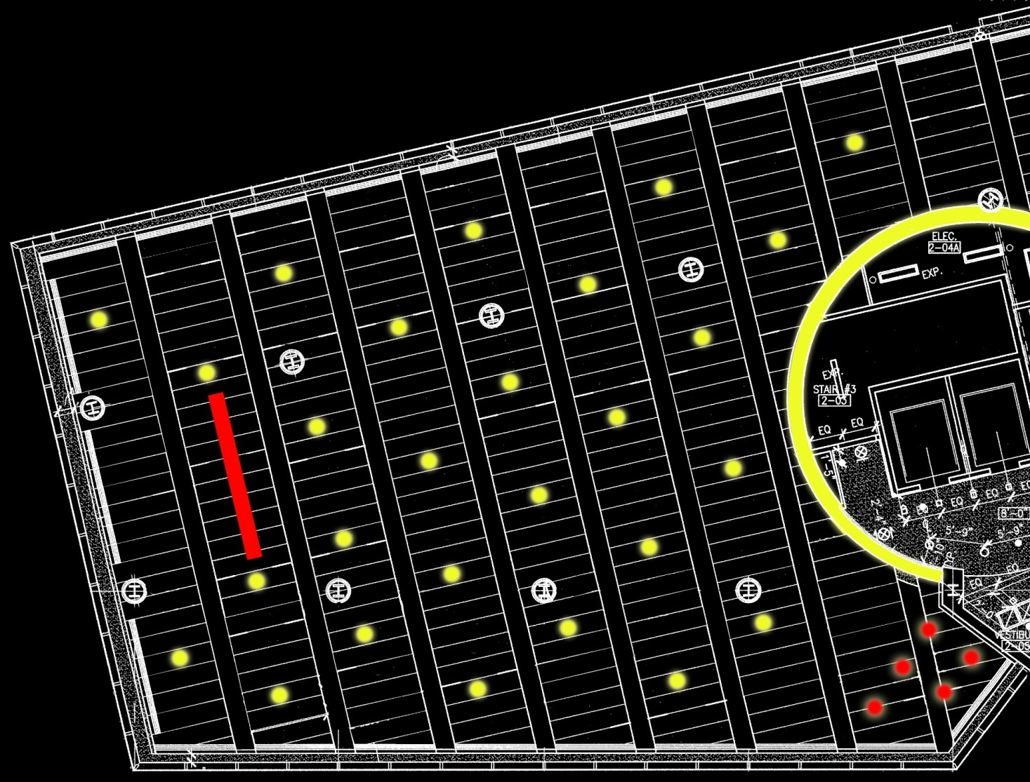
Option 2
Staggered layout to minimize scallops from columns
Outdoor Space Classroom Lower Lobby Auditorium
Notes:
The two systems would not be turned on simultaneously
Cool toned strips for daytime
Recessed into ceiling to not take away from unique architecture of ceiling
Warm toned downlighting for night time
Also recessed
The two floors of the levator lobby have wall washes
The upper floor is washed as a point of interest
The lower wall is washes to guide people to the elevators because it is most apparent

Slide 28
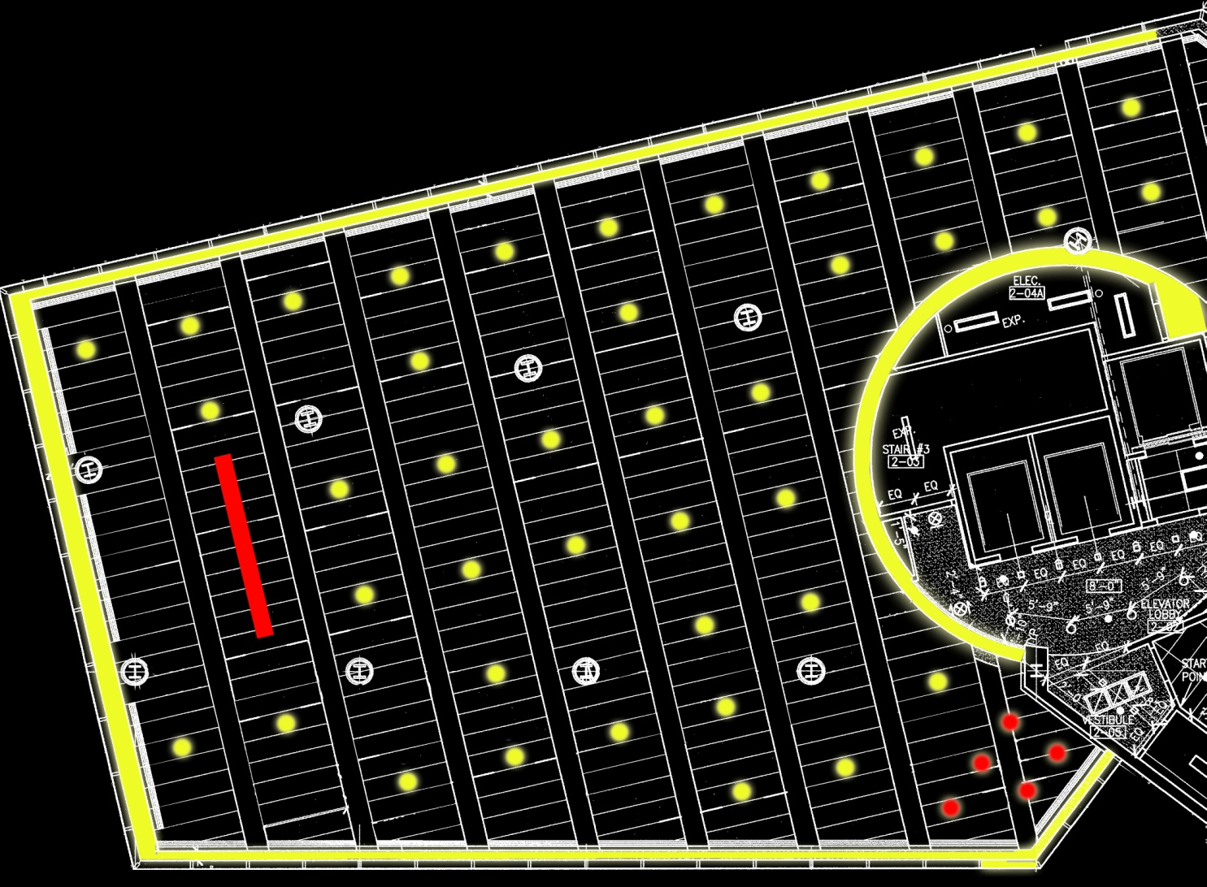
Option 2
Outdoor Space Classroom Lower Lobby Auditorium
Notes:
The two systems would not be turned on simultaneously
Cool toned strips for daytime
Recessed into ceiling to not take away from unique architecture of ceiling
Warm toned downlighting for night time
Also recessed
The two floors of the levator lobby have wall washes
The upper floor is washed as a point of interest
The lower wall is washes to guide people to the elevators because it is most apparent

Slide 29

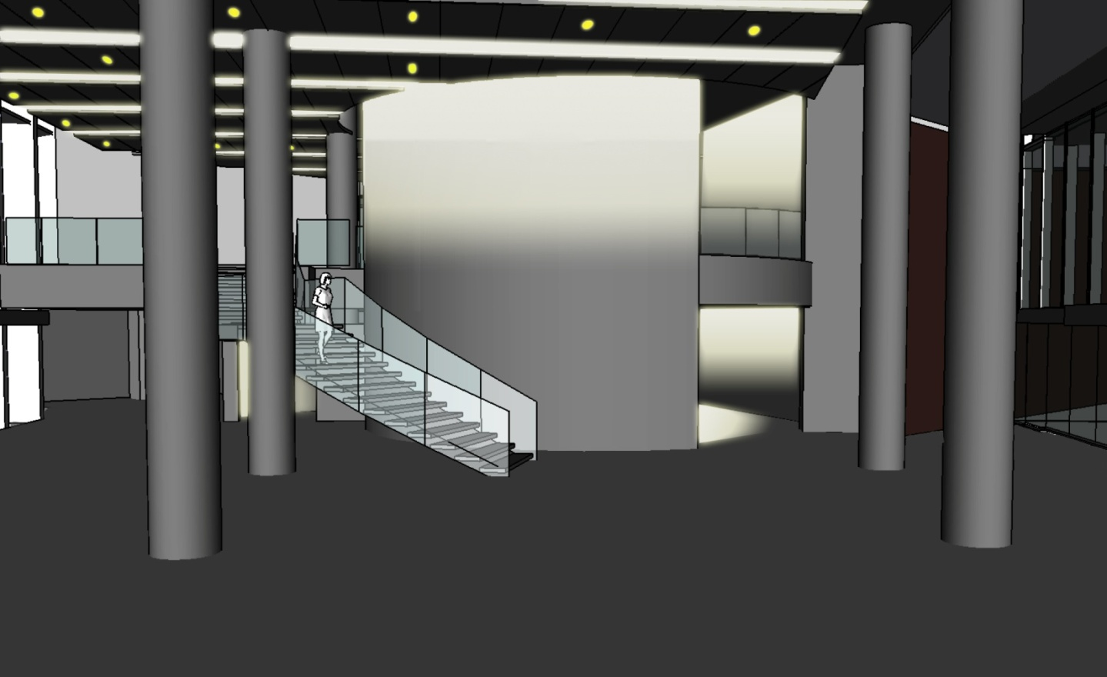
Design Concepts
Downlighting
Linear Fluorescent
Accent ceramic tile wall
Light Attraction for elevator
Outdoor Space Classroom Lower Lobby Auditorium
Notes:
The two systems would not be turned on simultaneously
Cool toned strips for daytime
Recessed into ceiling to not take away from unique architecture of ceiling
Warm toned downlighting for night time
Also recessed
The two floors of the levator lobby have wall washes
The upper floor is washed as a point of interest
The lower wall is washes to guide people to the elevators because it is most apparent

Slide 30

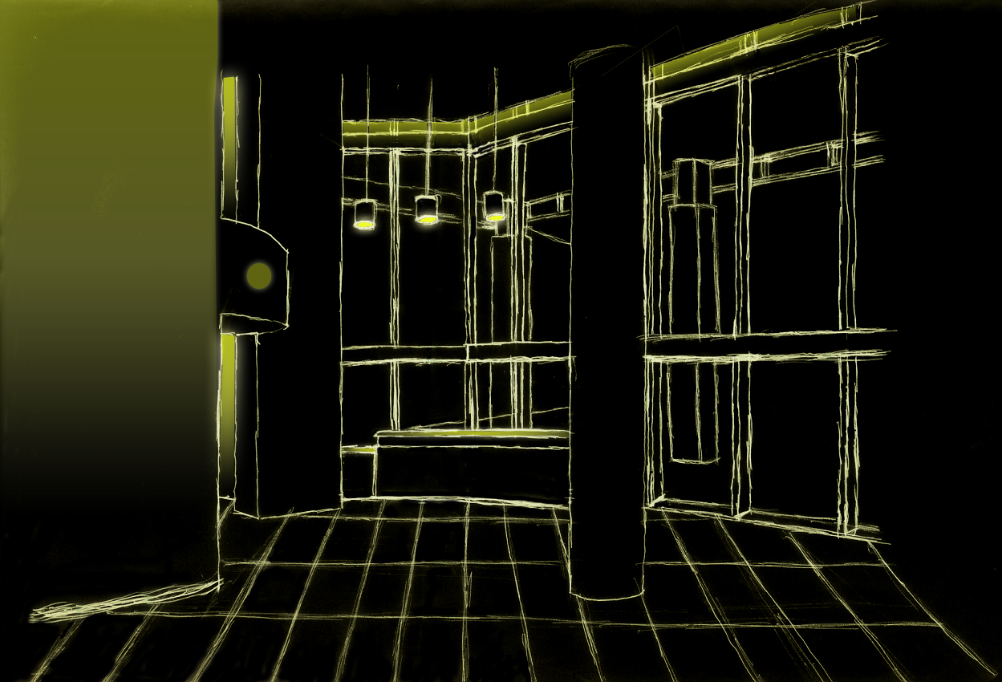
Design Concepts
Pendant task lighting
Ceiling
Slot
Decorative
Sconce
Light Attraction for Elevator
Outdoor Space Classroom Lower Lobby Auditorium
Notes:
The two systems would not be turned on simultaneously
Cool toned strips for daytime
Recessed into ceiling to not take away from unique architecture of ceiling
Warm toned downlighting for night time
Also recessed
The two floors of the levator lobby have wall washes
The upper floor is washed as a point of interest
The lower wall is washes to guide people to the elevators because it is most apparent

Slide 31
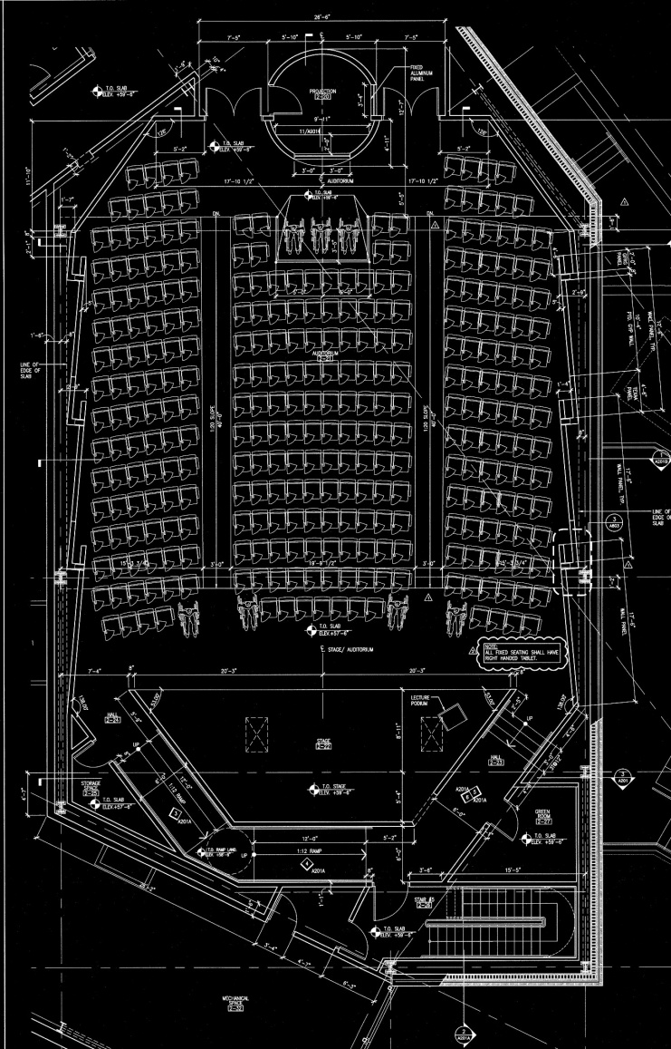
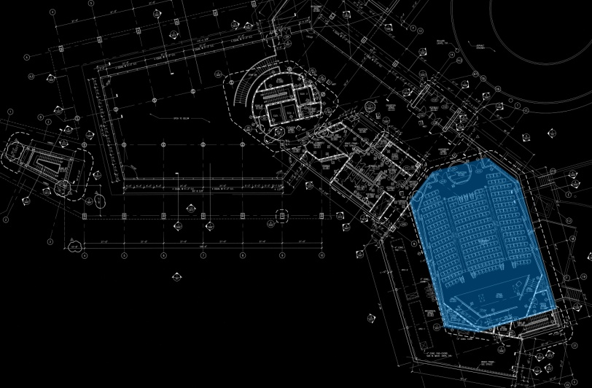
General Information
Outdoor Space Classroom Lower Lobby Auditorium
Notes:
Location
2nd Floor
Functions
Lectures with or without the projector screen
Drama performances
Tasks
Reading and writing
Observing projection screen
Features
Staggered walls with pockets to hide luminaires in
Staggered and sloped ceiling with coves to illuminate ceiling
Stage area at a lower level with slope

Slide 32
General Info Plan
GWB
Metal Fascia
Acoustic Panel
Perforated GWB
Ceramic Tile
Outdoor Space Classroom Lower Lobby Auditorium
Notes:
Location
2nd Floor
Functions
Lectures with or without the projector screen
Drama performances
Tasks
Reading and writing
Observing projection screen
Features
Staggered walls with pockets to hide luminaires in
Staggered and sloped ceiling with coves to illuminate ceiling
Stage area at a lower level with slope

Slide 33
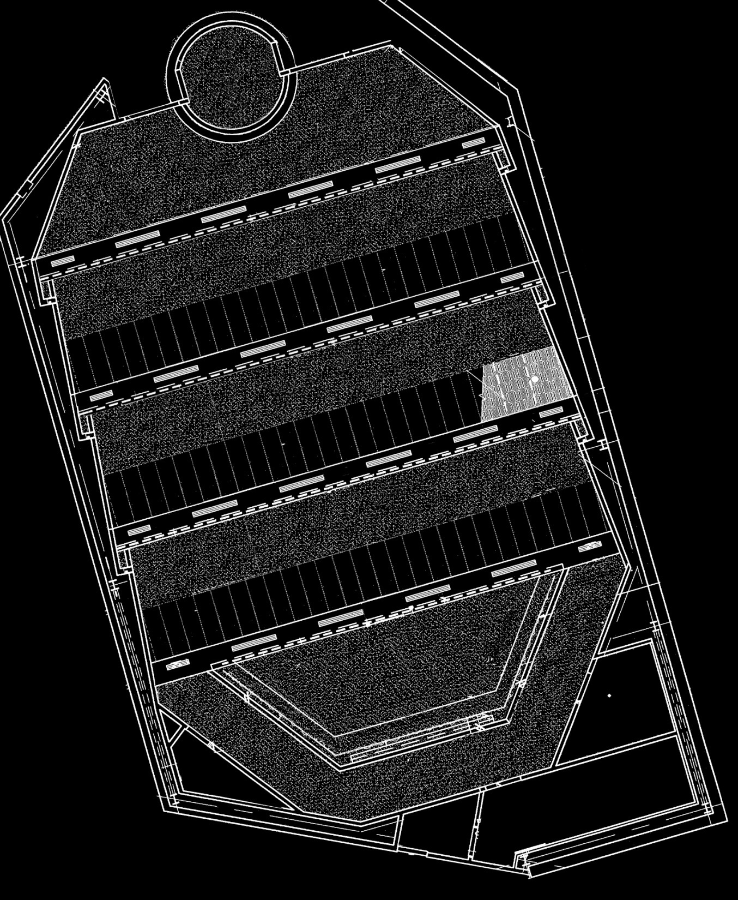
General Info RCP
Glass Fibre Reinforced
Gypsum Panel w/ TEXAA
Acoustic Covering
Perforated Glass Fiber Reinforced Gypsum Panel
GWB w/ TEXAA Acoustic Covering
Outdoor Space Classroom Lower Lobby Auditorium
GWB
Notes:
Location
2nd Floor
Functions
Lectures with or without the projector screen
Drama performances
Tasks
Reading and writing
Observing projection screen
Features
Staggered walls with pockets to hide luminaires in
Staggered and sloped ceiling with coves to illuminate ceiling
Stage area at a lower level with slope

Slide 34
Design Goals
Conceal light to not take away from architecture
Provide a modern appearance
Controls for different scenes
Accent interesting ceiling and staggered walls
Provide sufficient light levels for students
Outdoor Space Classroom Lower Lobby Auditorium
Notes:
The architect designed a very interesting space
Having suspended fixtures would cause clutter and take away from their work
Conceal fixtures as much as possible
Continue with the modern theme with high tech appearance luminiares
Because of the multiple functions, controls are very important to give the client the uses of the spaces which they desired
Insufficient light levels are a strain on students’ eyes and should be a high priority

Slide 35
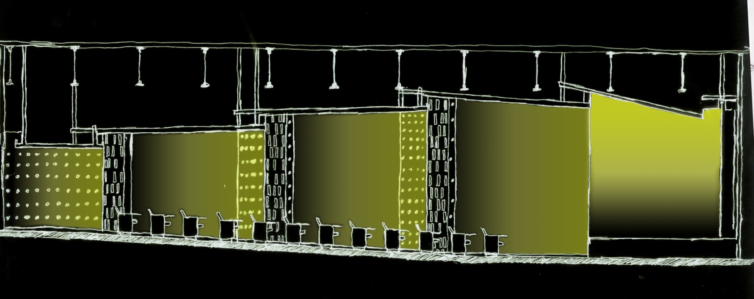
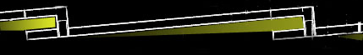
Section
Lateral Wall Wash
Outdoor Space Classroom Lower Lobby Auditorium
  Outdoor Space Classroom Lower Lobby Auditorium
Notes:
The walls are staggered as shown in the partial wall diagram below
There are overlaps to conceal luminaires
This will allow for lateral wall washes which are interesting because they are not seen as much as vertical ones
The cove distributions were not shown in this diagram for clarity

Slide 36
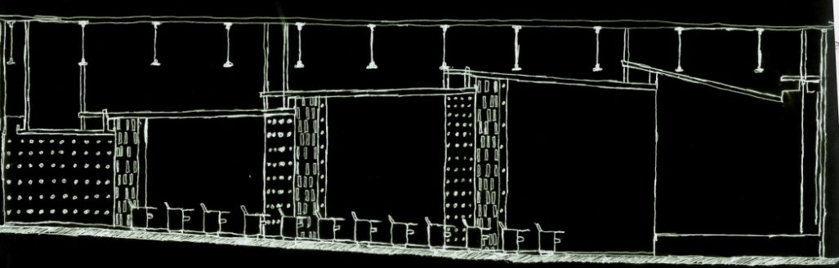
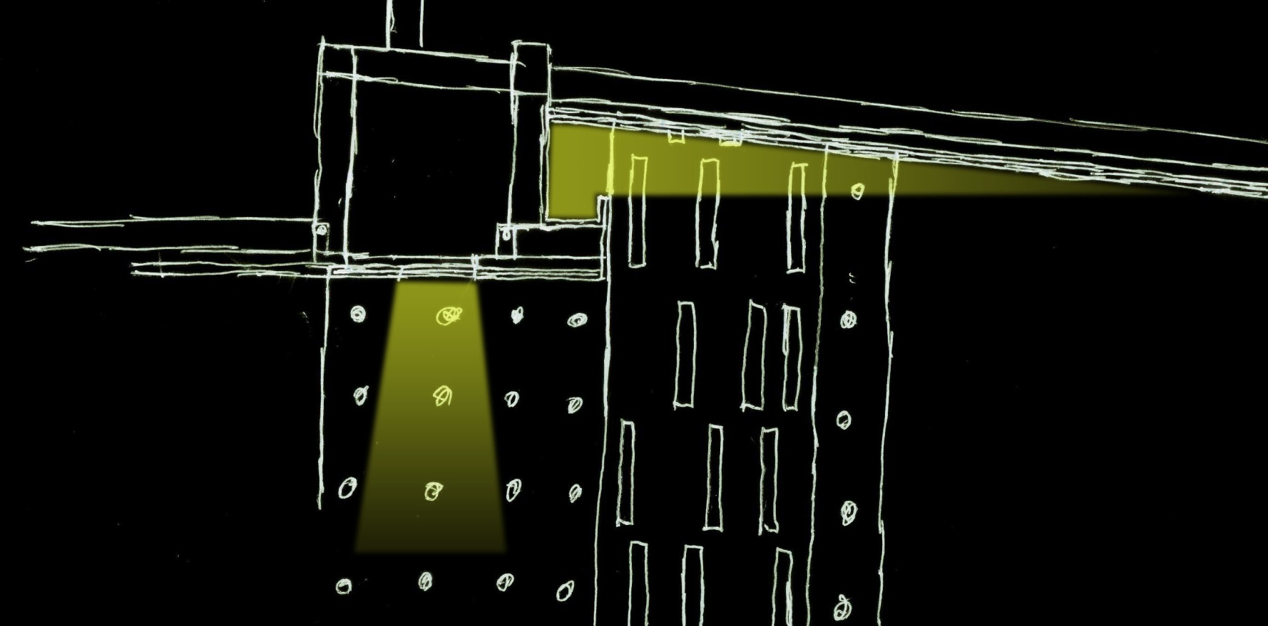
Staggered Ceiling Typical Detail
Linear Task
Lighting
Staggered Ceiling
Cove Lighting
Outdoor Space Classroom Lower Lobby Auditorium
Notes:
Cove fixture to accent architect’s interesting ceiling
Strip fixture to provide general task lighting for students

Slide 37
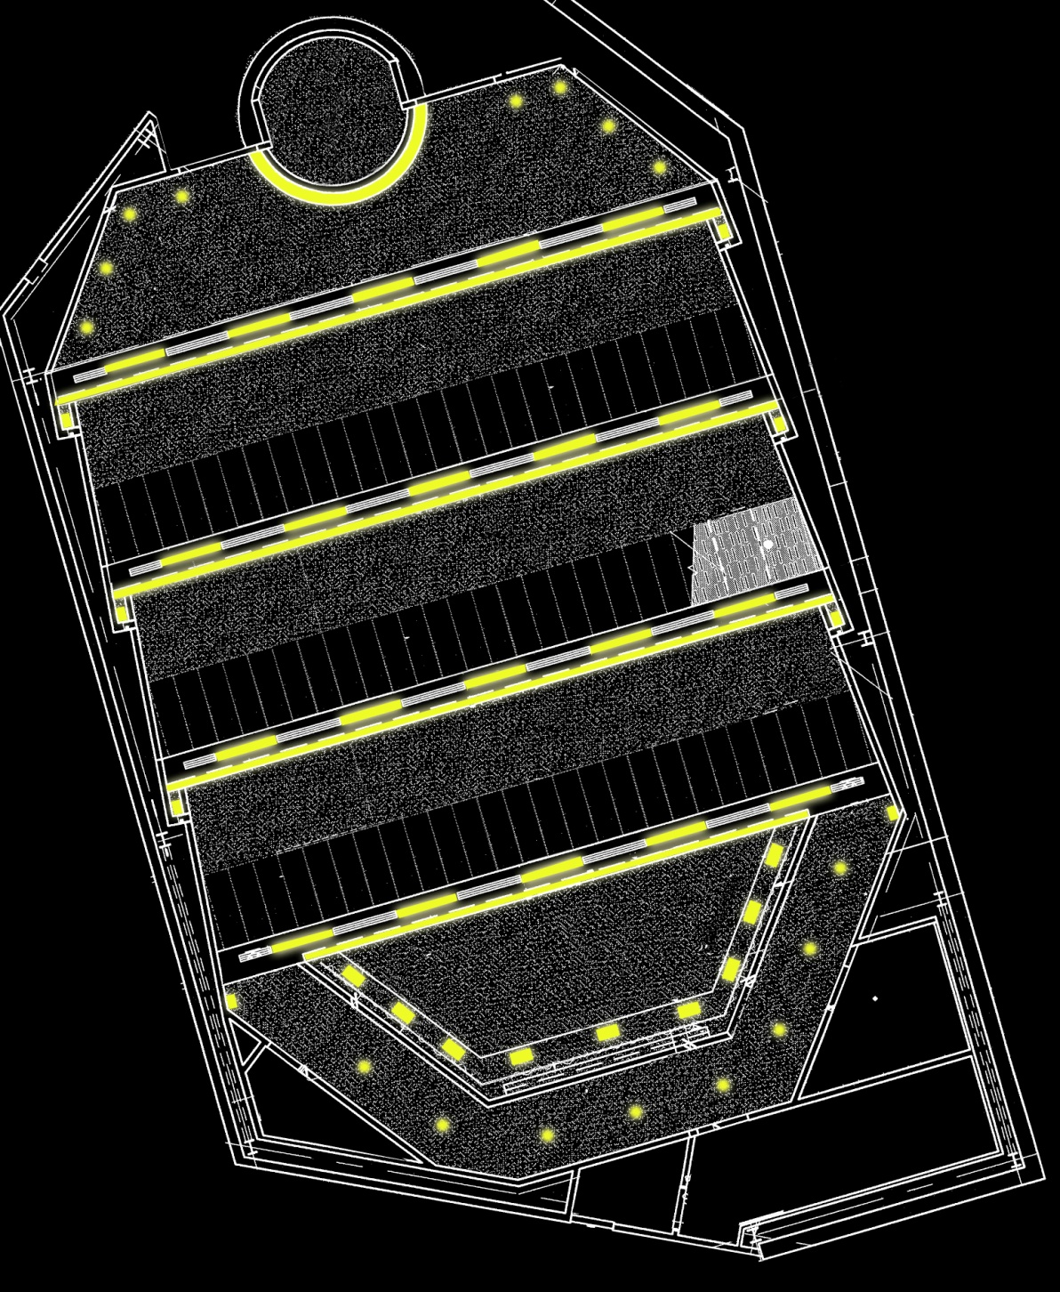
RCP
Wall Washers
Ceramic Tile Wall Cove
Fluorescent
Downlighting
Linear Task
Lighting
Outdoor Space Classroom Lower Lobby Auditorium
Staggered
Ceiling Cove
Horizontal Wall
Washer
Notes:
Cove fixture to accent architect’s interesting ceiling
Strip fixture to provide general task lighting for students

Slide 38

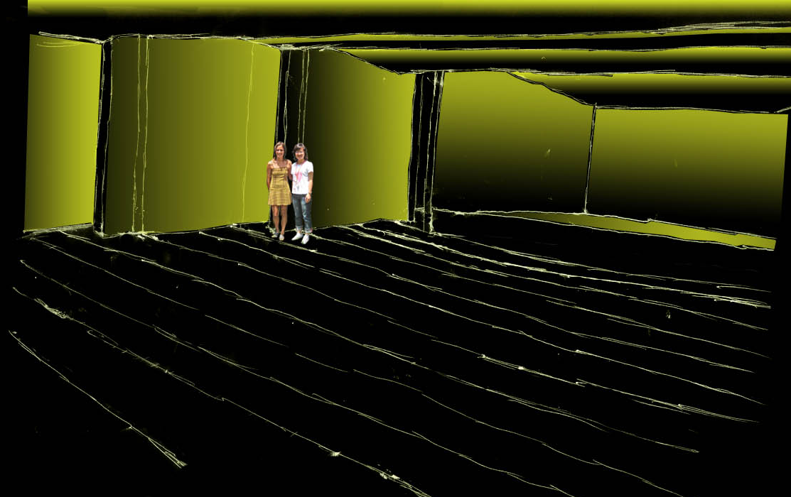
Ceiling Graze and Wall Wash
Outdoor Space Classroom Lower Lobby Auditorium
Notes:
Cove fixture to accent architect’s interesting ceiling
Strip fixture to provide general task lighting for students
Issues with glare control at the side wall wash closest to stage because there is no offset of wall to hide luminaires in

Slide 39
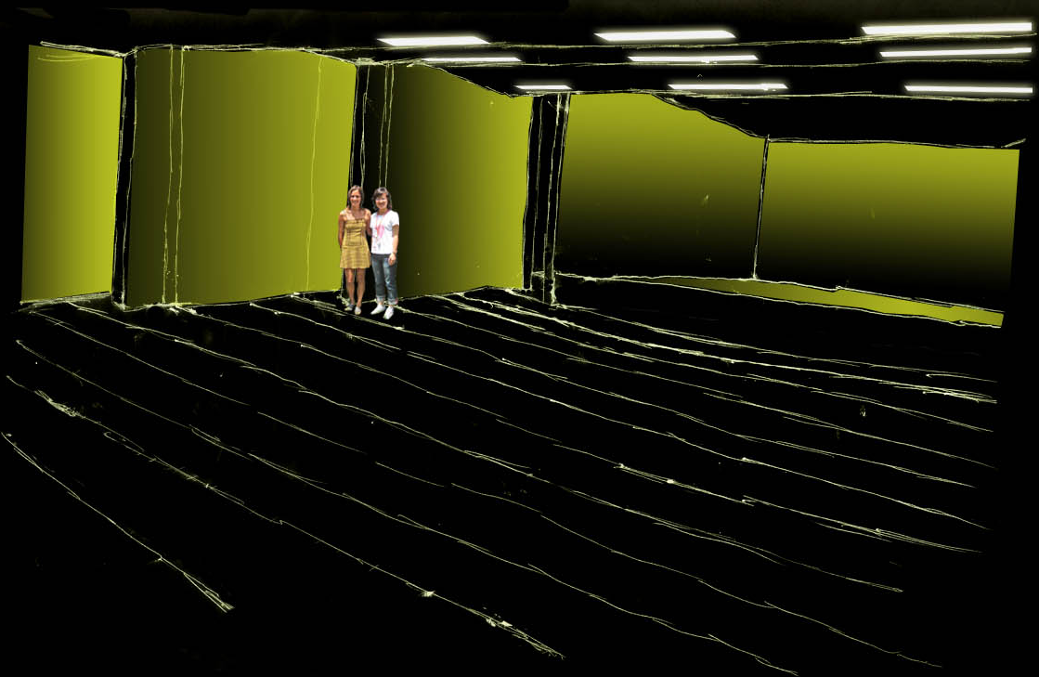
Linear Task Lighting and Wall Wash
Outdoor Space Classroom Lower Lobby Auditorium
Notes:
Cove fixture to accent architect’s interesting ceiling
Strip fixture to provide general task lighting for students

Slide 40
Questions?
Notes:
Cove fixture to accent architect’s interesting ceiling
Strip fixture to provide general task lighting for students

